Slide 1


VIBes –project
Mental health-supporting activities for young people in the Oulu region

Slide 2


’’ALL vibeS oK’’
The VIBEs project, which promotes young people’s mental health, gets its name from both a wordplay and a deeper message. The word vibes refers to a mood, feeling, or atmosphere in English – and that is exactly what the project is all about: creating positive, supportive, and hope-inspiring “vibes” in young people’s everyday lives.
It is also a counterstatement to the “good vibes only” mentality. When talking about mental health, it is important to recognize that all kinds of emotions are valid, and that young people should be able to talk openly about how they are feeling.
Different vibes can call for different things. For one person, it might be exercise; for another, culture or creativity. And sometimes, your body simply needs to slow down, relax, and enjoy some self-care.

Slide 3

Key objectives of the project:
Addressing long waiting times: Reduce the impact of long waiting lists for mental health services by providing young people with more quickly accessible support and low-threshold services. The aim is to ensure that young people can access some level of support when needed, even before seeking formal mental health services.
Supporting young people during transitional periods: Provide particular support for young people going through major life transitions, such as moving from comprehensive school to upper secondary education, and help prevent social exclusion by offering direct support, activities, and opportunities to build new networks.
Low-threshold activities: Offer young people easy access to low-threshold mental health tools, activities, and support in the Oulu region.
Different ways to support mental health: Introduce young people to a variety of options and support networks that can promote mental well-being, such as physical activity, cultural activities, and body care. These can serve as important forms of support alongside formal healthcare services.
Involving businesses in youth mental health: Engage businesses in the Oulu region in promoting young people’s mental health by offering young people opportunities to try services and activities that support their well-being.

Slide 4

VIBes
-pass

Slide 5

How the VIBEs Pass Works?
The VIBEs Pass will be distributed in autumn 2026 to all 9th-grade students and first-year students at the pilot schools.
The pilot schools are: Tuira School, Oulu International School, OSAO Kempele, and Oulun suomalaisen yhteiskoulun lukio.
The pass is available in both Finnish and English.
The pass includes unlimited-use services (including a collection of sports and physical activity services provided by the City of Oulu), special offers for young people, and free services that can be redeemed using a VIBEs code.
Using the code, young people can try four (4) wellbeing services of their choice provided by our partner organizations, free of charge during 2026.
The pass offers services in three different categories: Culture, Sports, and Wellbeing.

Slide 6
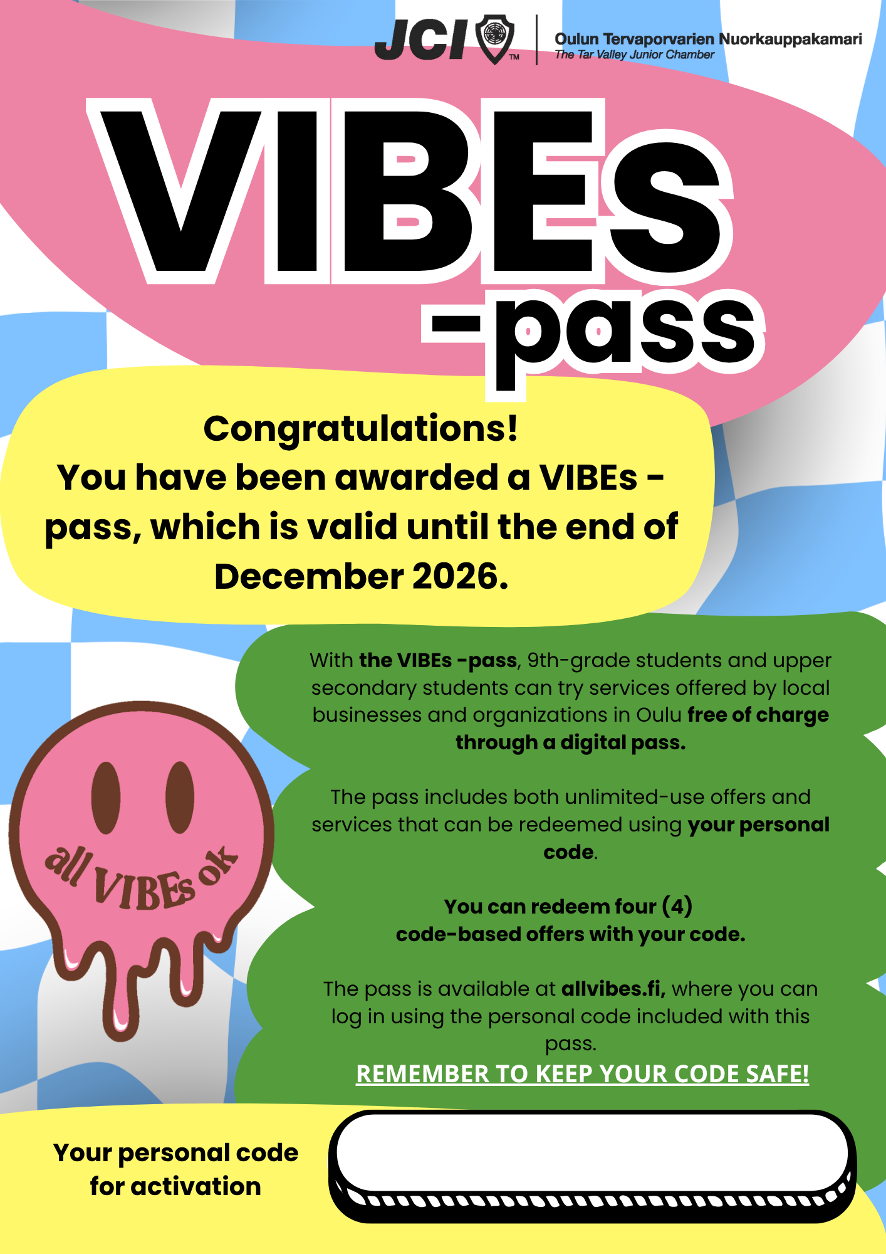
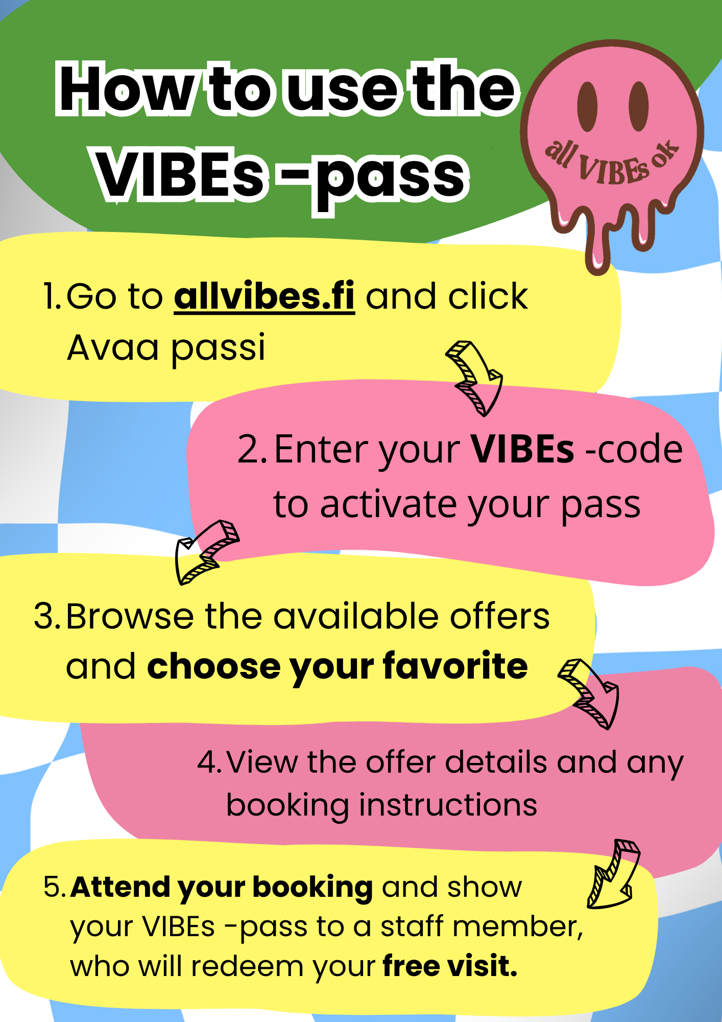
Passes distributed to young people
Each pass contains a personal VIBEs code that activates the pass.
Each young person receives one unique code, and it is their responsibility to keep it safe.

Slide 7
The pass is personal, but some services may be used together with a friend, depending on the agreements made with the participating businesses.
The passes and personal VIBEs codes will be distributed during student guidance sessions at the beginning of autumn 2026. Materials and instructions for activating and using the pass will be provided to the schools’ designated contact persons.
The pass does not collect personal data or maintain a register of its users.
At the beginning of 2027, the use of the pass will be analyzed, with the aim of expanding the service to include more service providers as well as more young people.

Slide 8
You can try out the demo version of pass at:
https://passi.stag.allvibes.fi/

Slide 9























Slide 10
Coming soon: ALL VIBES OK –PODCAST @ sPOTIFY
All VIBEs Ok is a youth-focused podcast about mental health, real-life struggles, identity, relationships, and finding your own way in life — with honesty, humor, and the reminder that not every vibe has to be a good one.
HOSTED BY TYTTILOTTA AALLOSTO

Slide 11

Through a fundraising, private individuals can also help support VIBEs’ activities.
Fundraising organizer: Oulun Tervaporvarien Nuorkauppakamari ry
Contact information: vibes@jciouluntervaporvarit.fi
Small-scale fundraising permit number: RA/2026/897
Bank account: FI88 5741 4020 2049 34
MobilePay number: 42752
Fundraising period: 1 August – 31 October 2026

Slide 12
Important info for schools!
Please distribute 1 pass per student. Each pass is coded with a personal code assigned to the individual student.
You do not need to collect a name list unless you wish to keep track of which students have received a pass. However, the list must not be shared with VIBEs staff for data protection reasons.
Please emphasize that students will need their personal code every time they log in to the website. A new code cannot be issued, so students should keep their code safe, for example by saving it on their phone. VIBEs is not responsible if the code falls into the wrong hands.
In spring 2027, VIBEs will provide schools with a survey about young people’s experiences using the pass. We kindly ask you to share the survey with students through the communication channel you use, or alternatively have students complete the survey during a lesson.

